Slide 1

Note: The data and information in this document is reflective of a hypothetical situation and client. This document is to be used for KPMG Virtual Internship purposes only.
Sprocket Central Pty Ltd
Data analytics approach
[Division Name] - [Engagement Manager], [Senior Consultant], [Junior Consultant]

Slide 2
Note: The data and information in this document is reflective of a hypothetical situation and client. This document is to be used for KPMG Virtual Internship purposes only.
Agenda
Introduction
Data Exploration
Model Development
Interpretation

Slide 3
Note: The data and information in this document is reflective of a hypothetical situation and client. This document is to be used for KPMG Virtual Internship purposes only.
Introduction
New Customers Analysis.
Targeting high value customers based on customer demographics and attributes
Age Distribution
Gender
Wealth Segment
Bike Purchase(past_3_years_bike_related_purchases)
Number of Cars Owned
State
Job Industry Category

Slide 4
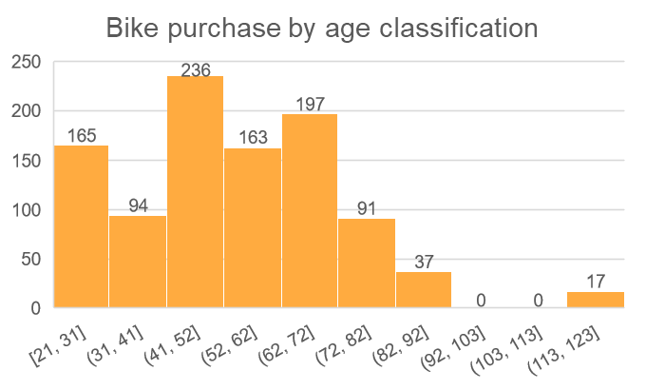
Note: The data and information in this document is reflective of a hypothetical situation and client. This document is to be used for KPMG Virtual Internship purposes only.
Data Exploration
Age Distribution Analysis For New Customers
From the diagram we can deduce that new high customers are from the age group 41 – 52, followed by 62 -67, and 52 -62.
There are fewer customers from age 72 – 82, 82 -92, and 113 – 123.

Slide 5
As seen, female(513) leads male(470) for the purchase of bikes for the past 3 years by a difference of 43. By wealth segment, female leads in Mass customer and High net worth, while male leads in Affluent Customer.
Note: The data and information in this document is reflective of a hypothetical situation and client. This document is to be used for KPMG Virtual Internship purposes only.
Data Exploration
Gender Classification For New Customers

Slide 6
Note: The data and information in this document is reflective of a hypothetical situation and client. This document is to be used for KPMG Virtual Internship purposes only.
Data Exploration
Wealth Segment For New Customers
508 bikes purchased by Mass Customers Individuals.
251 bikes purchase by High Net Worth individuals
241 bikes purchased by Affluent customers.
NSW leads the highest purchase of bikes by 506, it holds a significant figure from the other states therefore it should be highly prioritized.

Slide 7
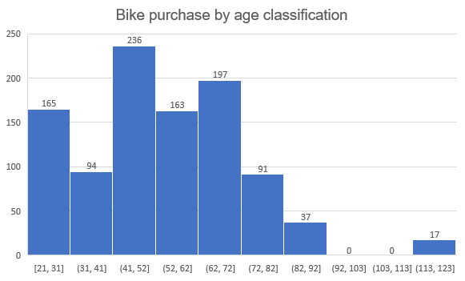
Note: The data and information in this document is reflective of a hypothetical situation and client. This document is to be used for KPMG Virtual Internship purposes only.
Data Exploration
Bike Purchase
(past_3_years_bike_related_purchases)
The least age is 21 and the highest age is 123.
From the diagram we can deduce that new high customers are from the age group 41 – 52, followed by 62 -67, and 52 -62.
There are fewer customers from age 72 – 82, 82 -92, and 113 – 123.
We can see that customers between the age 41 -52 are most likely to purchase bikes frequently.
Also NSW, has a higher purchase in state level by 506.

Slide 8
Note: The data and information in this document is reflective of a hypothetical situation and client. This document is to be used for KPMG Virtual Internship purposes only.
Data Exploration
Number of New Customers that owns a Car

Slide 9
Note: The data and information in this document is reflective of a hypothetical situation and client. This document is to be used for KPMG Virtual Internship purposes only.
Model Development
Classifying High Value Customers based on Analysis
Customers aged 41- 52 purchased the highest number of bikes
Females are high valued customers when compared to male customers.
Customers from Finance, Manufacturing and Health industry purchased more.
Customers living in New South Wales and Victoria.

Slide 10
Note: The data and information in this document is reflective of a hypothetical situation and client. This document is to be used for KPMG Virtual Internship purposes only.
Interpretation
Females purchased a total of 27, 057 bikes while males purchase a total of 24, 262 bikes therefore more priority and support should be given to the females, as they prove to be the target audience.

Slide 11
Note: The data and information in this document is reflective of a hypothetical situation and client. This document is to be used for KPMG Virtual Internship purposes only.
THANK YOU

